Slide 1
CS97: Introduction to Data Science
07: K Nearest Neighbor
Instructor: Shichang Zhang
shichang@ucla.edu

Slide 2
So far …
We have learned
Linear regression for regression
Simple linear regression
Multivariate linear regression
Polynomial linear regression
Logistic regression for classification
Binary classification
Multi-class classification
Model selection for linear regression and logistic regression
Feature selection, hyperparameter tuning (in regularization)

Slide 3
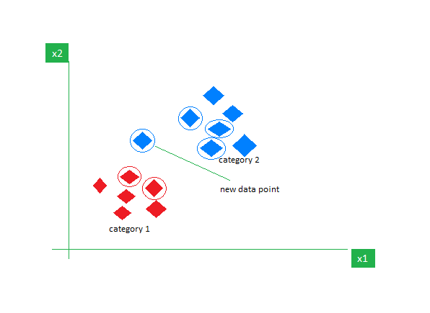
Next
Another Classification Algorithm: K-Nearest Neighbor
Fundamental Assumption: data points (as vectors) that are close by should be considered as similar (i.e., have the same target prediction).
https://www.geeksforgeeks.org/k-nearest-neighbours/

Slide 4
Content
KNN for regression
KNN for classification
Model selection for KNN

Slide 5
Data
The Advertising data set consists of the sales of that product in 200 different markets, along with advertising budgets for the product in each of those markets for three different media: TV, radio, and newspaper. Everything is given in units of $1000.
,
TV | radio | newspaper | sales
230.1 | 37.8 | 69.2 | 22.1
44.5 | 39.3 | 45.1 | 10.4
17.2 | 45.9 | 69.3 | 9.3
151.5 | 41.3 | 58.5 | 18.5
180.8 | 10.8 | 58.4 | 12.9
Some of the figures in this presentation are taken from "An Introduction to Statistical Learning, with applications in R" (Springer, 2013) with permission from the authors: G. James, D. Witten, T. Hastie and R. Tibshirani "
Notes:
Supposed we were asked by a client to provide advice on how to improve sales of a particular product.
Does that footnote belong on this slide?

Slide 6
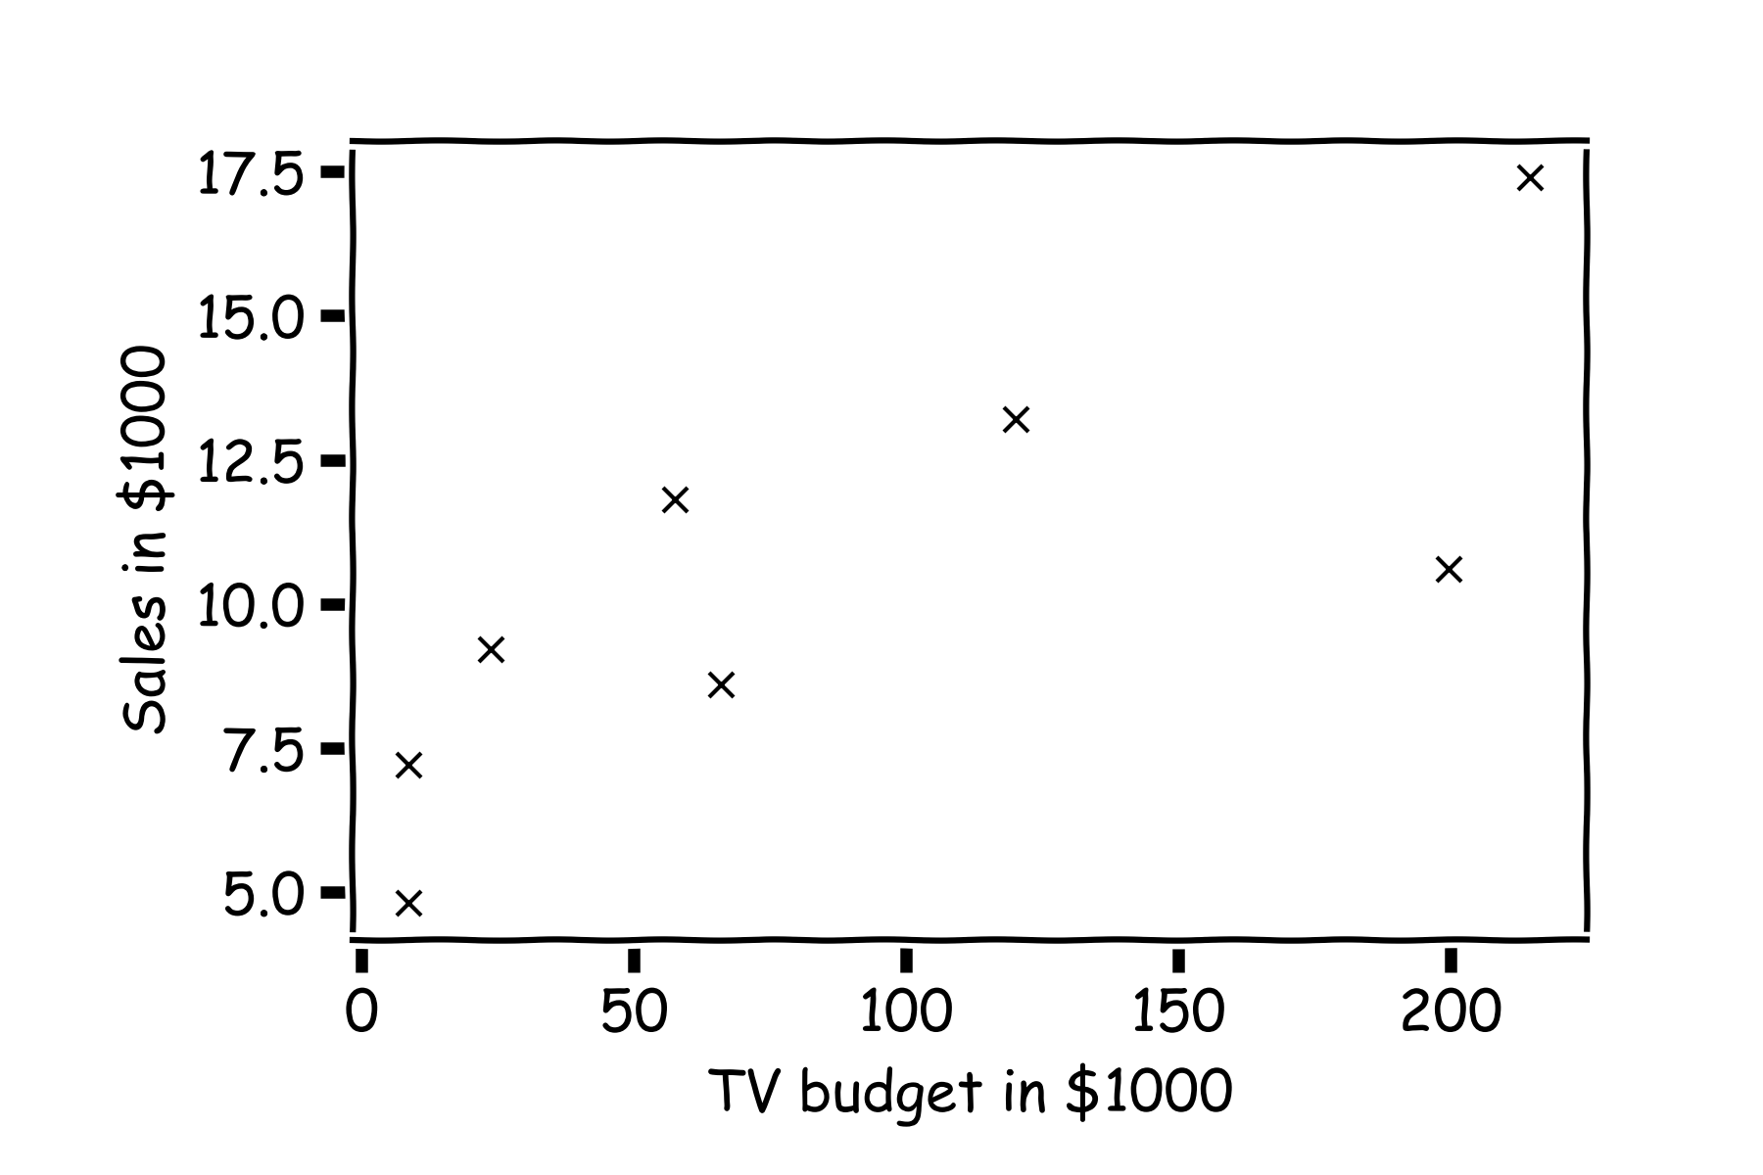
Statistical Model
Don’t worry about “statistical”, it just tries to say the model will be different if we are given different training dataset
y
x

Slide 7
Statistical Model
H$ow do we find \hat{f}\left(x\right)?$
What is the value of y at this $x$?

Slide 8
Statistical Model
H$ow do we find \hat{f}\left(x\right)?$
or this one?

Slide 9
Statistical Model
Simple idea is to take the mean of all y’s, $\hat{f}\left(x\right)=\frac{1}{n}\sum_{1}^{n}{y_{i}}$

Slide 10
Better than global mean?
What is ${\hat{y}}_{q}$at some $x_{q }$?
Find distances to all other points $D(x_{q},x_{i})$
$${(x}_{p},y_{p})$$
$${\hat{y}}_{q}$$
Find the nearest neighbor, ${(x}_{p},y_{p})$
Predict ${\hat{y}}_{q}=y_{p}$
$$x_{q}$$
Notes:
Is it clear that x_q is really x_i,q? (DLS)
Imagine you survived the winter and spring quarters, and you’re sitting in a classroom and you don’t know the answer to a question. What would you do?

Slide 11
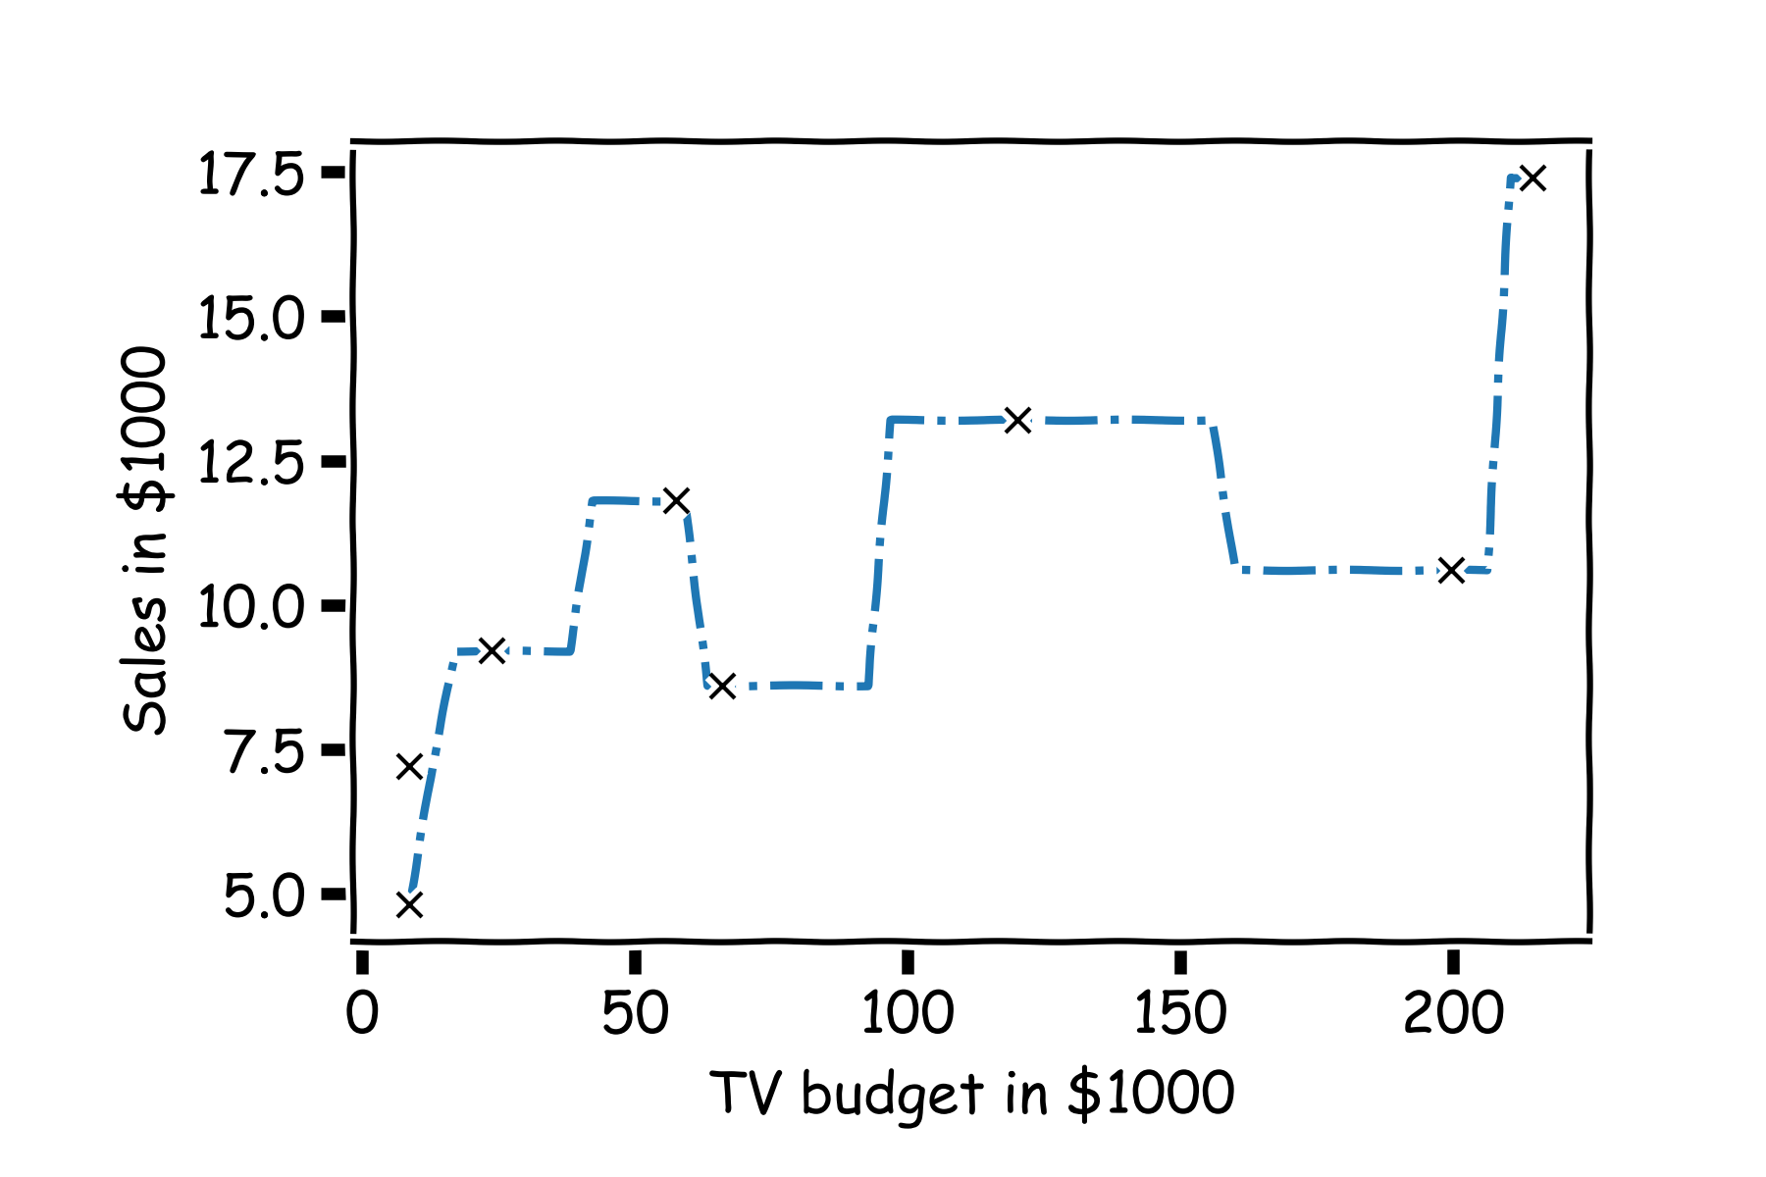
Simple Prediction Model
Do the same for “all” $x′s$

Slide 12
Extend the Prediction Model: from 1 neighbor to k neighbors
What is ${\hat{y}}_{q}$at some $x_{q }$?
Find distances to all other points $D(x_{q},x_{i})$
$${\hat{y}}_{q}$$
Find the k-nearest neighbors, $x_{q_{1}},…,x_{q_{k}}$
Predict $\hat{y_{q }}=\frac{1}{k}\sum_{i}^{k}{y_{q_{i}}}$
$$x_{q}$$
Notes:
Change indeces and show k-nearest
What if you don’t know the person who is sitting besides you?

Slide 13
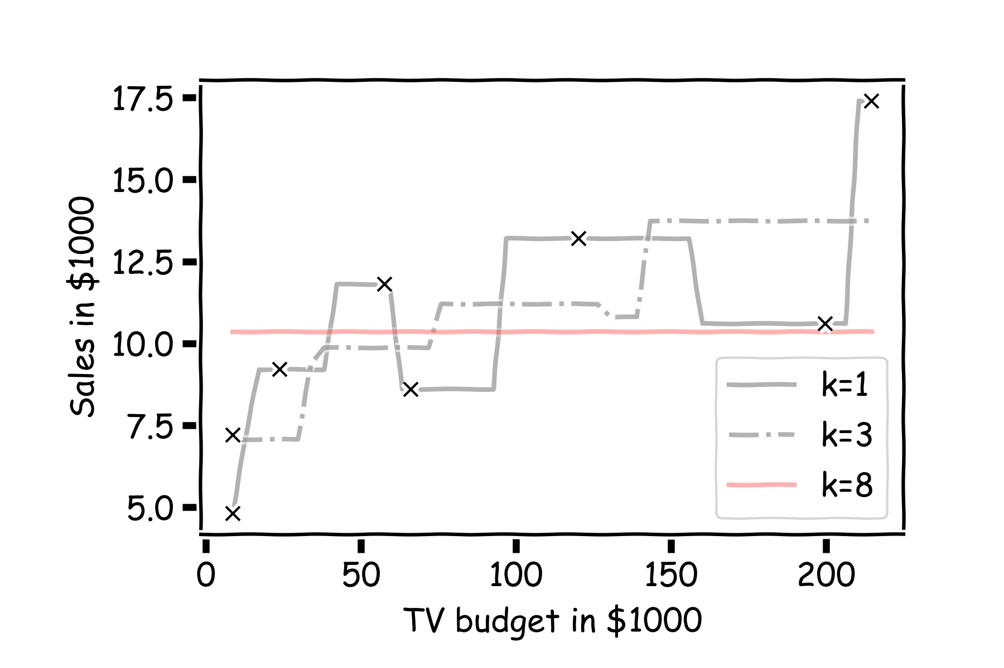
Simple Prediction Models
Notes:
Change indeces and show k-nearest
We get a smoother model for larger k

Slide 14

With more data points
We can try different k-models on more data
Notes:
Change indeces and show k-nearest

Slide 15
k-Nearest Neighbors
The k-Nearest Neighbor (kNN) model is an intuitive way to predict a quantitative response variable:
to predict a response for a set of observed predictor values, we use the responses of other observations most similar to it
Note: this strategy can also be applied in classification to predict a categorical variable.
Notes:
Change indeces and show k-nearest

Slide 16
k-Nearest Neighbors - kNN
For a fixed value of k, the predicted response for the $n$-th observation is the average of the observed response of the k-closest observations:
where $\left\{x_{n1},…,x_{nk}\right\}$ are the k observations most similar to $x_{n}$ (similar refers to a notion of distance between predictors).
Notes:
Note K-NN vs NN!! Notice y_hat instead of f_hat
I think the index on y_hat is wrong but I can’t change it b/c it’s an image. (DLS)

Slide 17
Error Evaluation for KNN

Slide 18
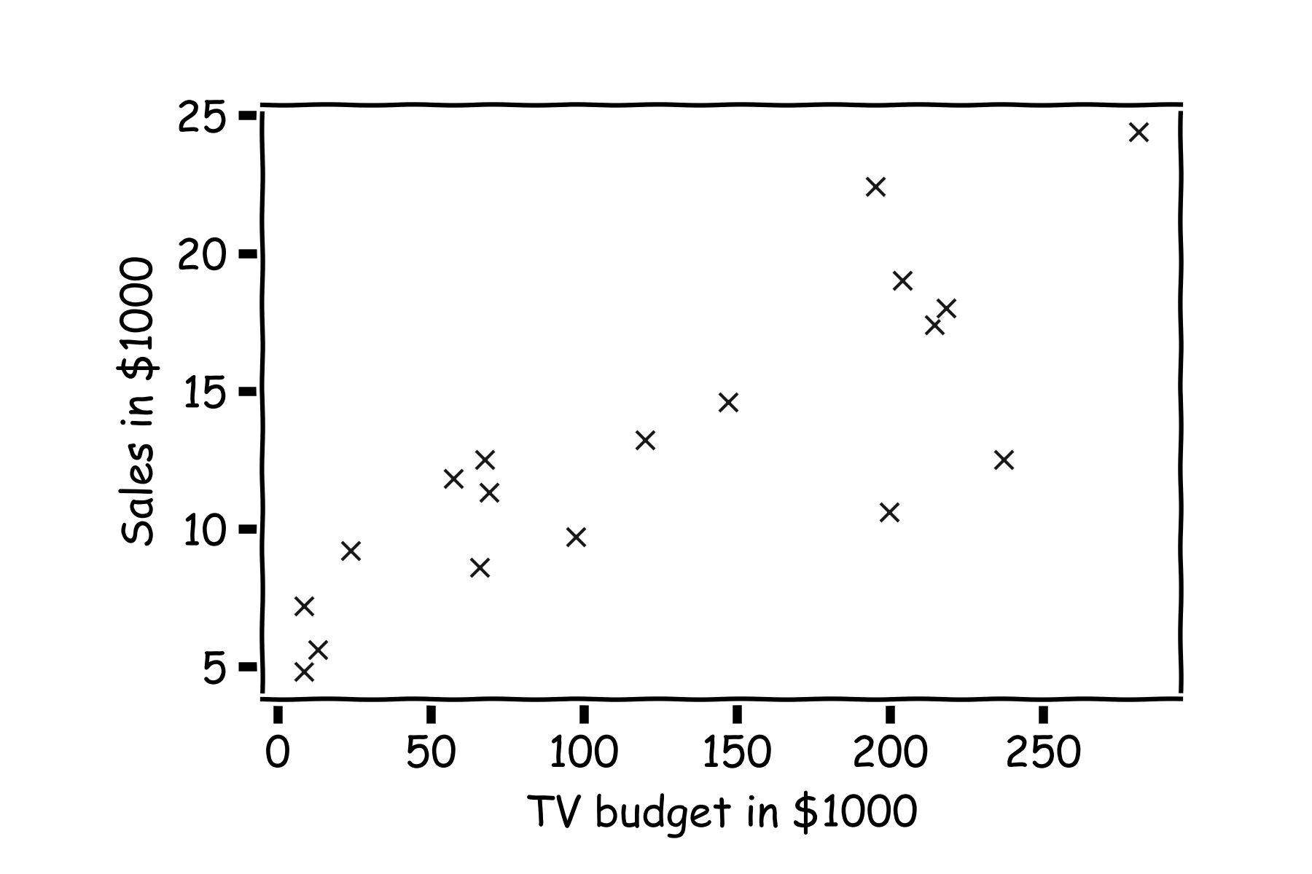
Error Evaluation
Start with some data.
Notes:
Change indeces and show k-nearest
Hint: I gave you a poll, a subset of you answered!

Slide 19
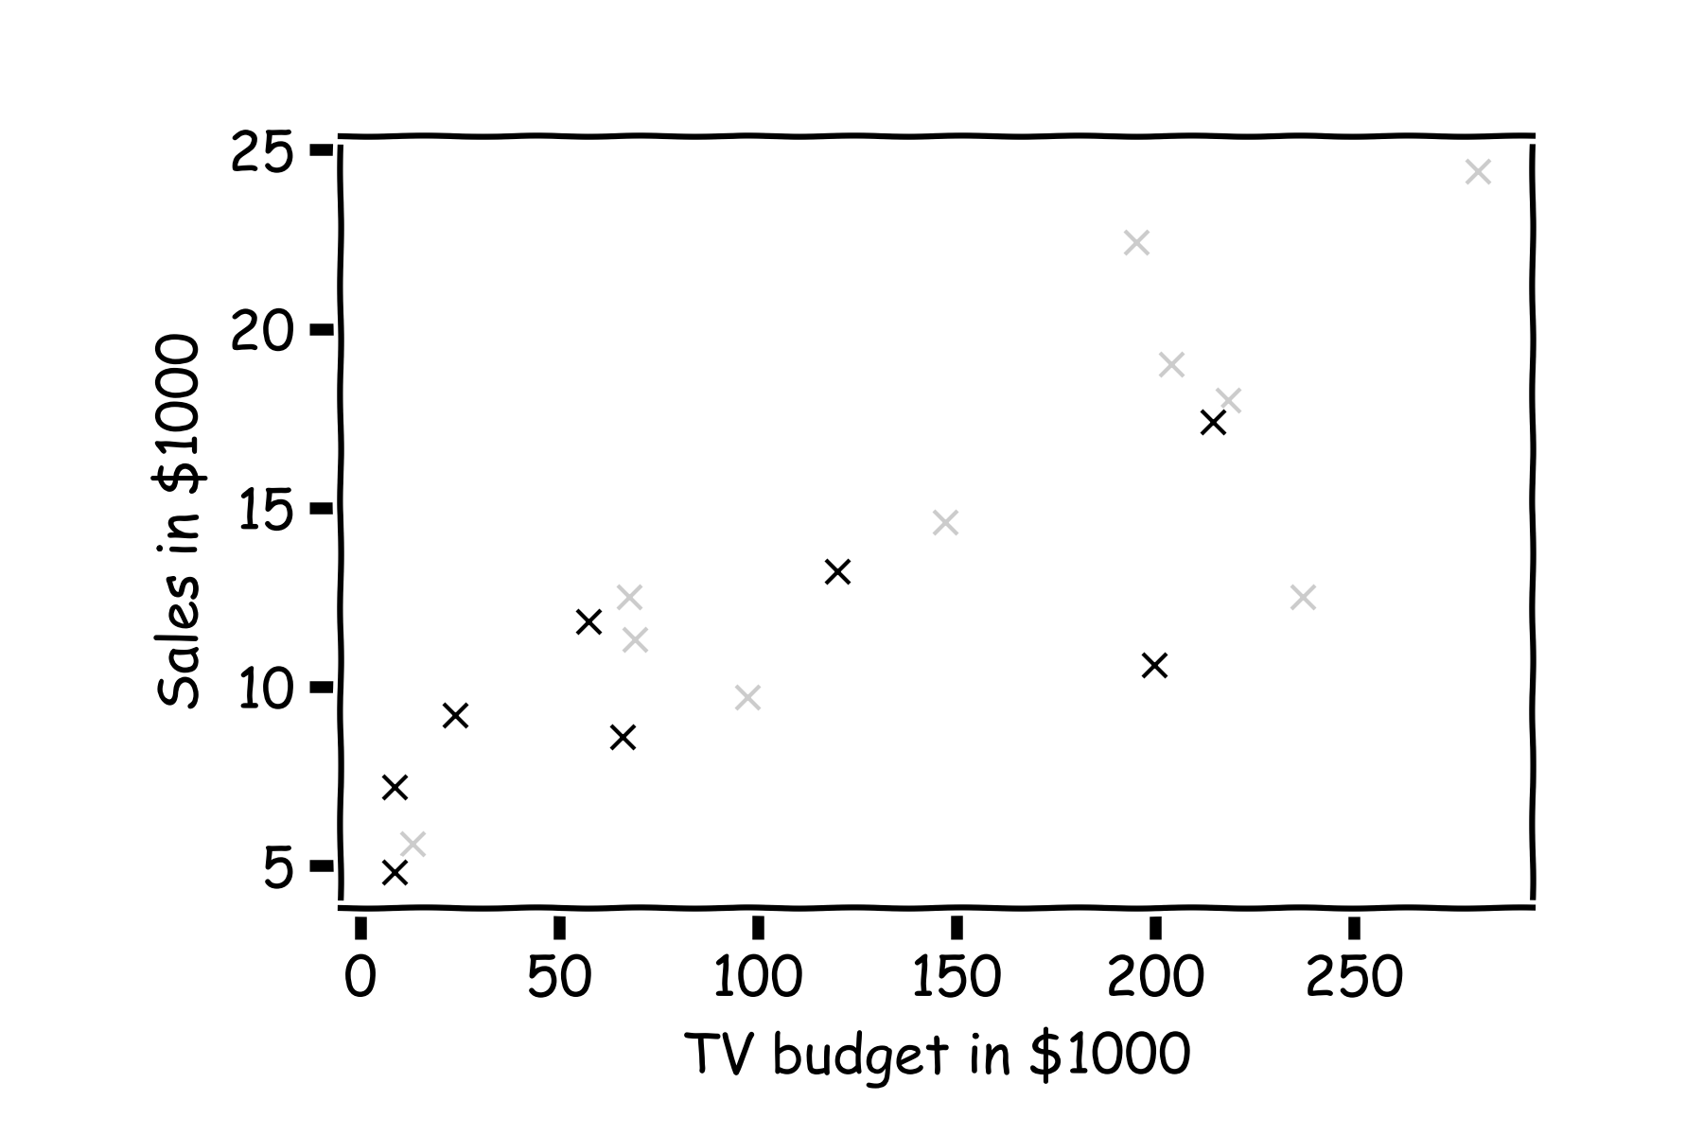
Error Evaluation
Hide some of the data from the model. This is called train-test split.
We use the train set to estimate $\hat{y},$ and the test set to evaluate the model.

Slide 20
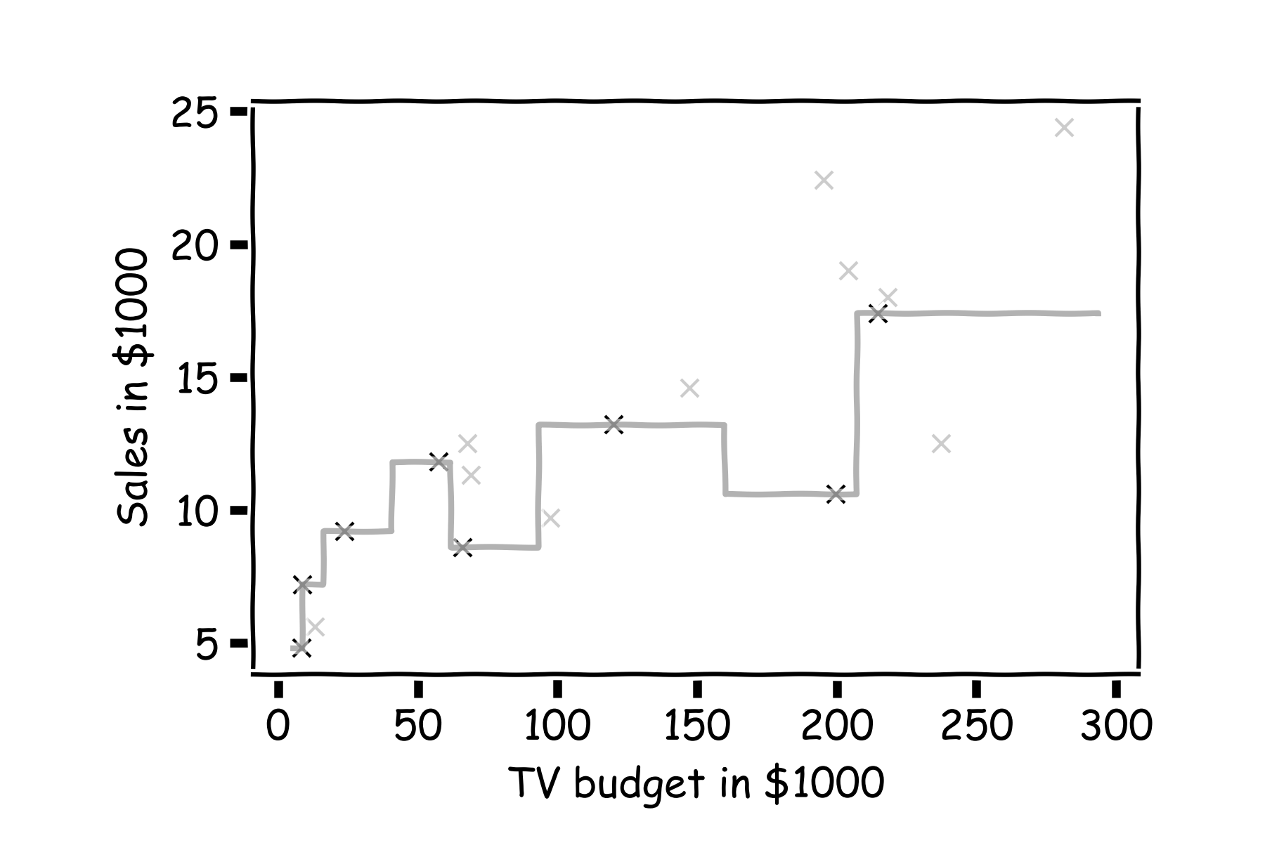
Error Evaluation
Estimate $\hat{y}$ for k=1 .
Notes:
Change indeces and show k-nearest

Slide 21
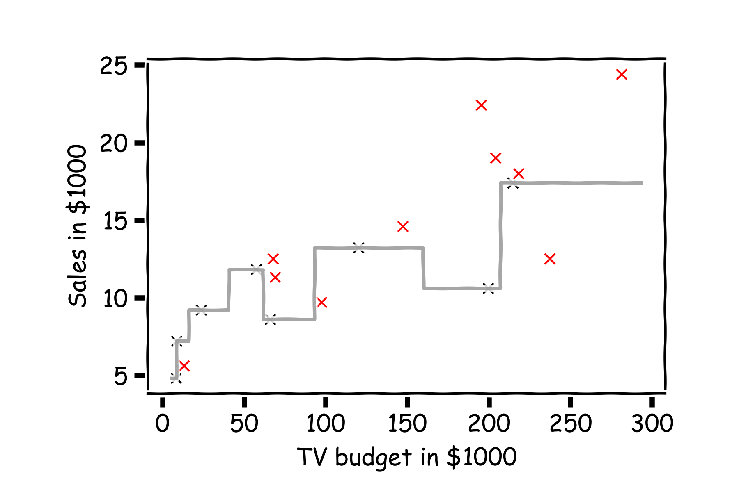
Error Evaluation
Now, we look at the data we have not used, the test data (red crosses).
Notes:
Change indeces and show k-nearest

Slide 22
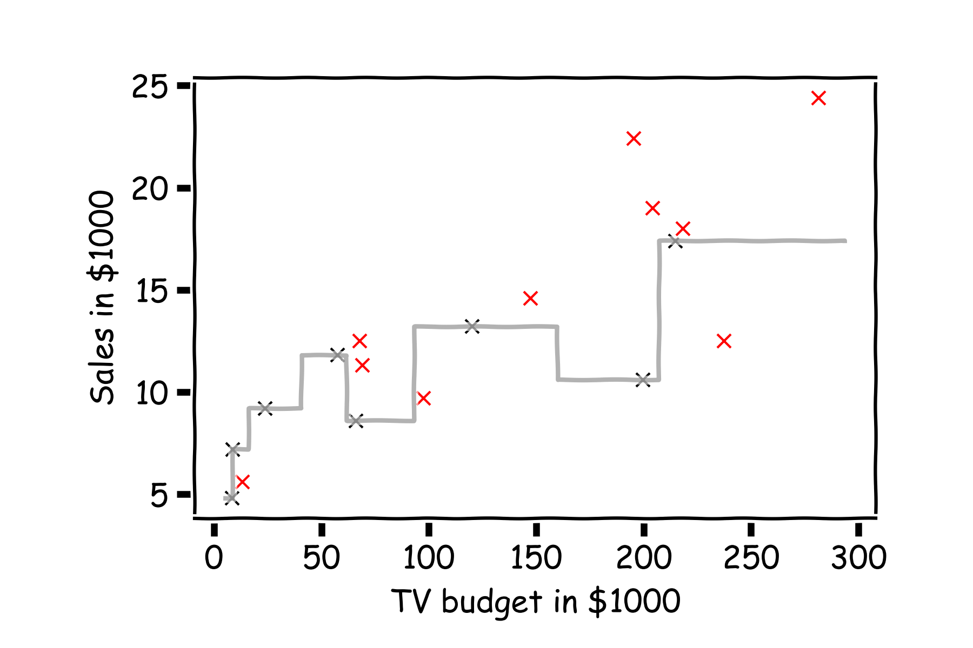
Error Evaluation
Calculate the ${\text{residuals} (y}_{i}−{\hat{y}}_{i}).$
Notes:
Change indeces and show k-nearest

Slide 23
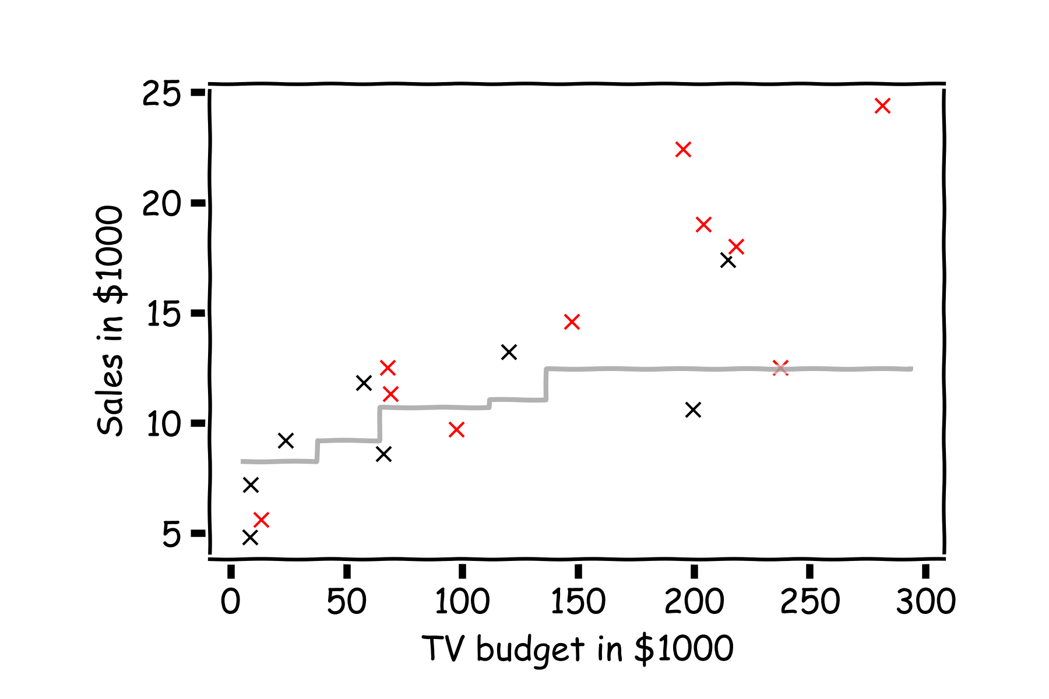
Error Evaluation
Do the same for k=3.
Notes:
Change indeces and show k-nearest

Slide 24
MSE and RMSE
A common loss function for KNN with numerical outcomes is the Mean Squared Error (MSE):
The square Root of the Mean of the Squared Errors (RMSE) is also commonly used.
Notes:
Change indeces and show k-nearest

Slide 25



Please download and install the Slido app on all computers you use
Audience Q&A Session
ⓘ Start presenting to display the audience questions on this slide.

Slide 26
Content
KNN for prediction
KNN for classification
Model selection for KNN

Slide 27
k-NN for Classification
How can we modify the k-NN approach for classification?
The approach here is the same as for k-NN regression: use the other available observations that are most similar to the observation we are trying to predict (classify into a group) based on the predictors at hand.
How do we classify which category a specific observation should be in based on its nearest neighbors?
The category that shows up the most among the nearest neighbors.

Slide 28
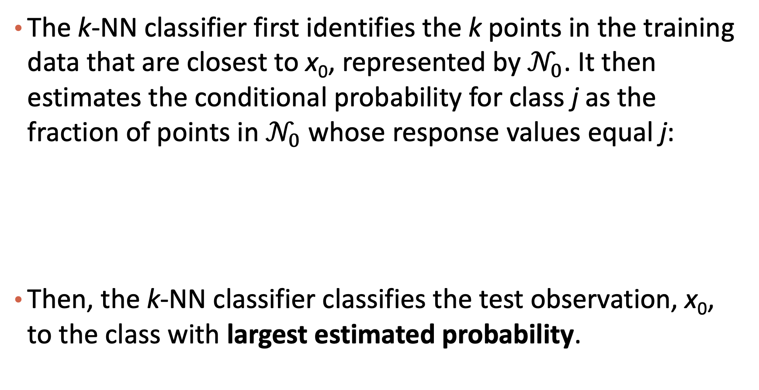
k-NN for Classification: formal definition
The k-NN classifier first identifies the k points in the training data that are closest to x₀, represented by $𝒩_{0}$. It then estimates the conditional probability for class j as the fraction of points in $𝒩_{0}$ whose response values equal j:
Then, the k-NN classifier classifies the test observation, x₀, to the class with largest estimated probability.
$$P\left(Y=j | X=x_{0}\right)=\frac{1}{k}\sum_{i{∈𝒩}_{0}}{I(y_{i}=j)}$$
A fancy way to say majority voting
$$I\left(y_{i}=j\right):indicator function, if y_{i}=j, it is 1;if y_{i}≠j, it is 0$$

Slide 29
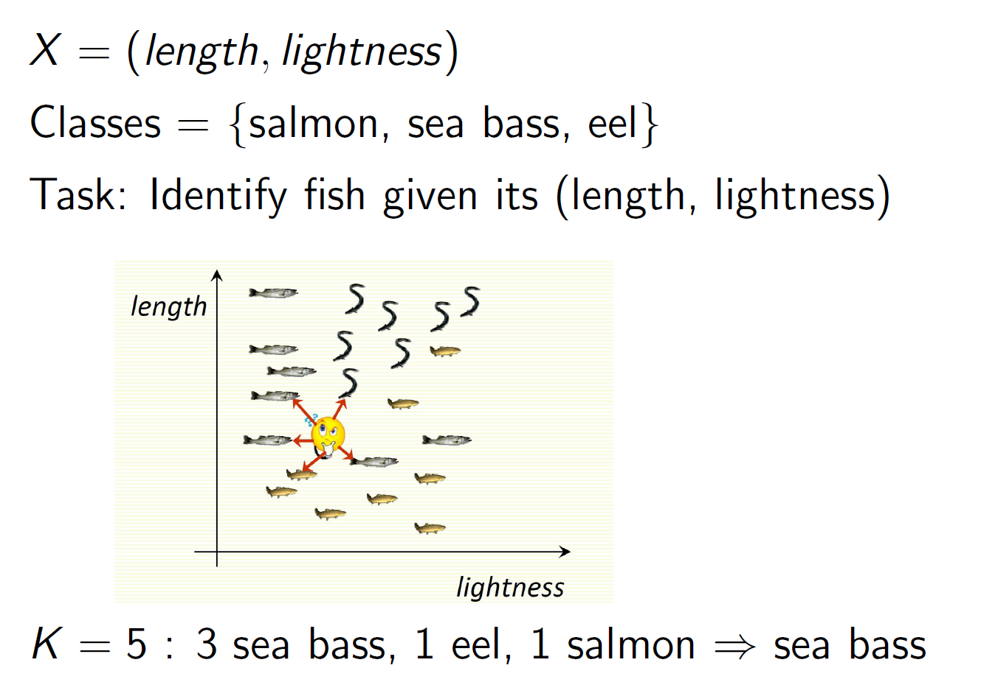
kNN Example

Slide 30
Estimated Probabilities in k-NN Classification

Slide 31
k-NN for Classification (cont.)
There are some issues that may arise:
How can we handle a tie?
What could be a major problem with always classifying to the most common group amongst the neighbors?
How can we handle this?
With a coin flip!
If one category is much more common than the others then all the predictions may be the same!
Rather than classifying with the most likely group, use a biased coin flip to decide which group to classify to.
Notes:
=> weighting neighbors by the inverse of their class size converts neighbor counts into the fraction of each class that falls in your K nearest neighbors
- weighting neighbors by their distances
- using a radius-based rule for gathering neighbors instead of the K nearest ones (often implemented in KNN packages)

Slide 32
k-NN with Multiple Predictors
How could we extend k-NN (both regression and classification) when there are multiple predictors?
We would need to define a measure of distance for observations in order to which are the most similar to the observation we are trying to predict.
Euclidean distance is a good option. To measure the distance of a new observation, x₀ from each observation in the data set, x_{i}:
$$D^{2}\left(x_{i},x_{0}\right)=\sum_{j=1}^{P}{{\left(x_{i,j}−x_{0,j}\right)}^{2}}$$

Slide 33
k-NN with Multiple Predictors (cont.)
But what must we be careful about when measuring distance?
1. Differences in variability in our predictors!
2. Having a mixture of quantitative and categorical predictors.
So what should be good practice? To determine closest neighbors when p > 1, you should first standardize the predictors! And you can even standardize the binaries if you want to include them.
Standardization: minus mean then divided by standard deviation
How else could we determine closeness in this multi-dimensional setting?
Notes:
1 -- if there is natural order among the data, convert them to numerical values based on the natural order.
[If the values are “Low”, “Intermediate”, and “High” (or more generally, if they at least have a natural order), then you can again make sense of coding them numerically as 1, 2, 3. ]
2 -- If there is no order and there are more than 2 categories, convert to one hot encoding.
[One possibility in the case is to put them equally spaced around a circle., since then the distance between any pair of them is the same. With 𝑁>3N>3 values , you may want to put them at the vertices of a regular simplex in 𝑁N-dimensional space. In other words, code them as (1,0,…,0), (0,1,0,…,0), …, (0, 0, .., 0, 1). Then the distance between any pair of values is the same.
-- If there is no order < 3 categories, convert to numeric.]
-- Numeric data:
You should normalize the data: subtract the mean and then divide by the standard deviation of that variable
(x-mu)/std distance function : Euclidean distance is the most used similarity function. Manhattan distance, Hamming Distance, Minkowski distance are different alternatives.
Jaccard distance if all your data is actually binary

Slide 34
k-NN Classification in Python
Performing kNN classification in python is done via KNeighborsClassifier in sklearn.neighbors.
An example:
Notes:
Score: accuracy

Slide 35
Content
KNN for prediction
KNN for classification
Model selection for KNN

Slide 36
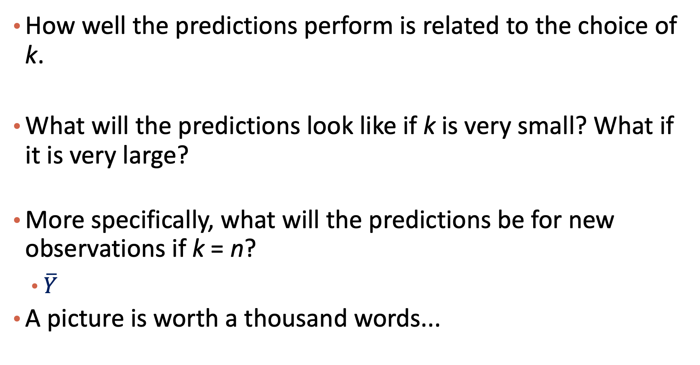
Review: Choice of k
How well the predictions perform is related to the choice of k.
What will the predictions look like if k is very small? What if it is very large?
More specifically, what will the predictions be for new observations if k = n?
$\overline{Y}$
A picture is worth a thousand words...
Notes:
Bias / Variance

Slide 37
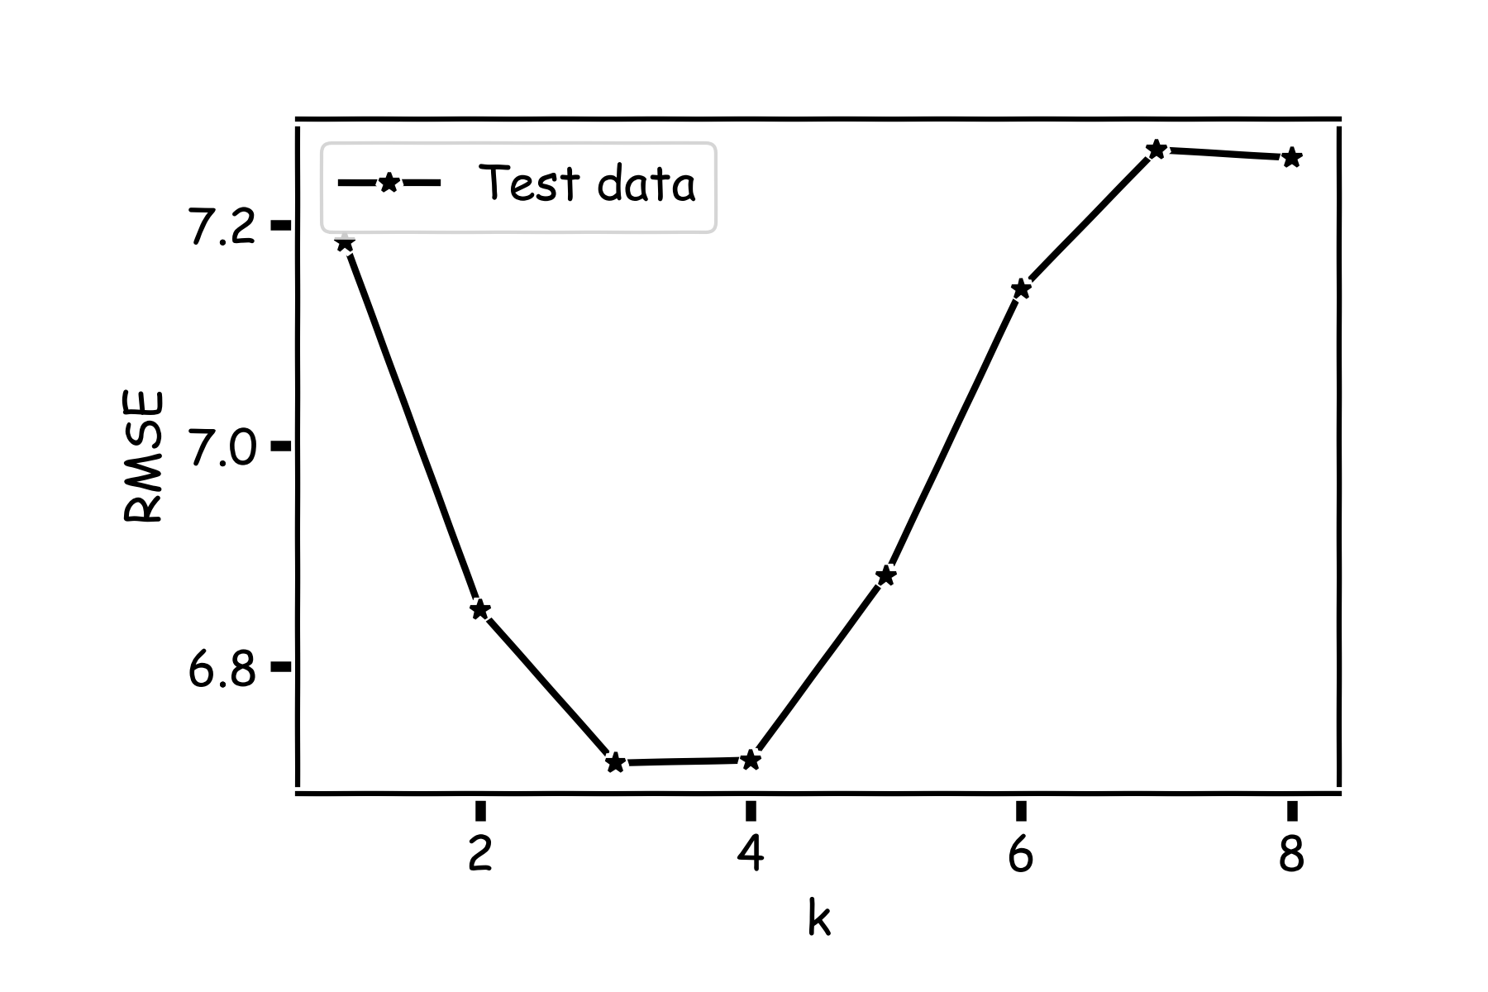
Choice of k matters

Slide 38
Choice of k matters
Recall our first simple, intuitive,
non-parametric model for regression –
the kNN model. We saw that it is vitally
important to select an appropriate k for
the data.
If the k is too small then the model is very sensitive to noise (since a new prediction is based on very few observed neighbors), and if the k is too large, the model tends towards making constant predictions.
A principled way to choose k is through cross validation.

Slide 39
kNN vs. Logistic Regression
kNN
No training. Slow testing (inference)
Logistic Regression
Slower training. Faster testing (inference)

Slide 40
Summary
K-nearest neighbor algorithm
Prediction
Classification
Model selection (how to choose K)

